Slide 1
Feature Selection
General steps
mutual_info_regression
Forest Fire
Auto MPG
Servo

Slide 2
General steps
k is used for number of features
SelectKBest[1] with mutual_info_regression[2] used for all k
Each time data fitted to linear models (linear SVR and LinearRegression) to get MSE from 10-Fold CV
MSE vs. k graph is drawn

Slide 3
mutual_info_regression[2]
Estimate mutual information for a continuous target variable.
Mutual information (MI) [1] between two random variables is a non-negative value, which measures the dependency between the variables. It is equal to zero if and only if two random variables are independent, and higher values mean higher dependency.
The function relies on nonparametric methods based on entropy estimation from k-nearest neighbors distances as described in [2] and [3]. Both methods are based on the idea originally proposed in [4].

Slide 4
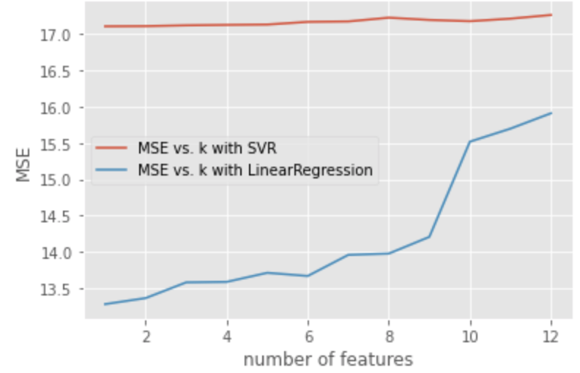
Forest Fire, final k=8[3]

Slide 5
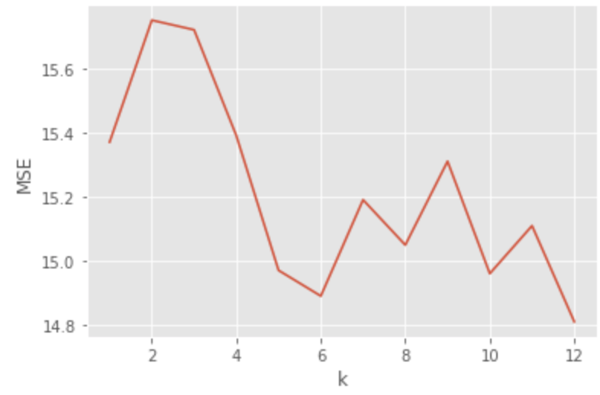
Forest Fire, check for k != 8
MSE: 13.587,#features selected=3, C=5.994,gamma:1000.000,Learning curves: Figure 1.a && Figure 1.b
MSE: 15.247,#features selected=3, C=56.234,gamma:0.1,Learning curves: Figure 2.a && Figure 2.b
Attempt to reduce error when #features selected=3 results in overfitting(case 1)
Optimal(does not overfit) C and gamma parameters when #features selected=3 results in higher MSE value(case 2)
#features from 1 to 12 are tested and lowest optimal MSE is when #features selected=12 for SVR(kernel=sigmoid)

Slide 6
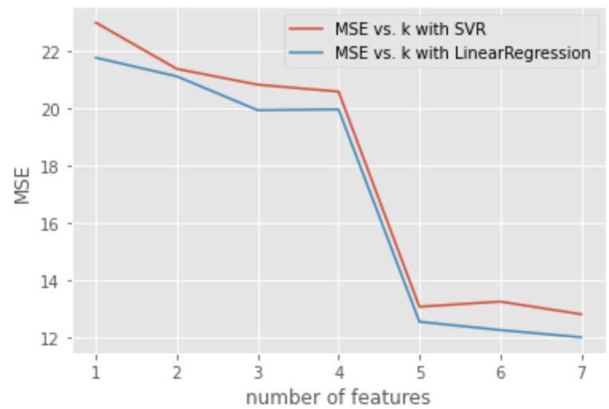
AutoMPG, k=7[4]

Slide 7
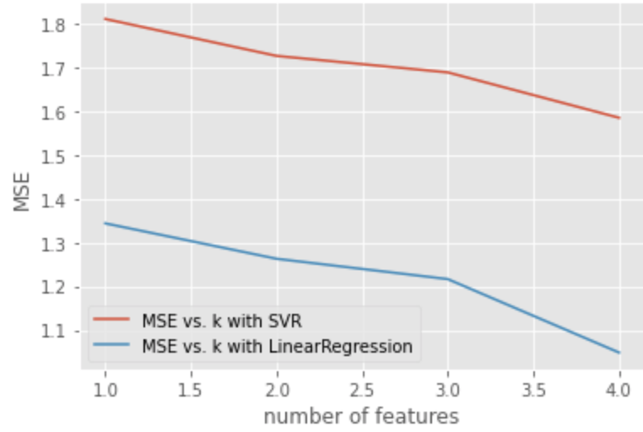
Servo, final k=4[5]

Slide 8
Refernces
[1]https://scikit-learn.org/stable/modules/generated/sklearn.feature_selection.SelectFromModel.html
[2]https://scikit-learn.org/stable/modules/generated/sklearn.feature_selection.mutual_info_regression.html#sklearn.feature_selection.mutual_info_regression
[3]https://colab.research.google.com/drive/19ygdatewU-VJlnzbNl5im2h3K3dx7k1I#scrollTo=omZiDYcvBYCF
[4]https://colab.research.google.com/drive/1qwk-wbcWGIvUmhLWDHVc_vFSOIcML5L0#scrollTo=Pm-igS5Vt7hd
[5]https://colab.research.google.com/drive/1iy2kljBiQ2Q2-30WyFjIjaqqfNOOrCrz#scrollTo=-0GzeGSP9vFn

